Slide 1


ONLINE FOOD DELIVERY APPLICATION
Submitted by: Swagatam Bardhan
Submission type : Individual
Batch: 12
LMS Id: developerswagatam@gmail.com
Program: Axis Bank - Fintech
Date: 31/05/2023

Slide 2

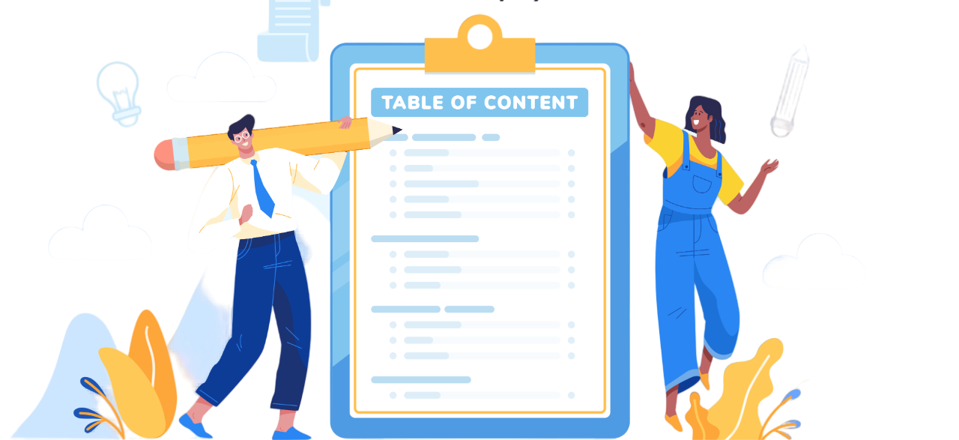
Table of Contents
Introduction
Project Overview
Architecture Design
User Interface Design
Front-end Development
Back-end Development
Conclusion
Future Work
References

Slide 3

Introduction
Hungry Hub is an online food delivery application where customer can order food from individual restaurant. It is an all-inclusive web application developed to enable customers to conveniently order food online and have them delivered right to their doorstep.
This is a full stack application, for backend I have used Spring Boot and for frontend I have used HTML, CSS and JavaScript
HUNGRY HUB

Slide 4

Project Overview
FUNTIONAL OVERVIEW
Customer Login/ Registration
Explore numerous Restaurants
Explore diverse menus
Admin access for Login
Admin Access to manage menus, restaurants, and customer details

Slide 5



Project Overview
TECHNOLOGY OVERVIEW
1. Front-end:
HTML, CSS, Java Script (Visual Studio Code)
2. Back-end:
Spring boot, Java (Eclipse IDE)
3. Database:
MySQL (SQL Yog)
4. Postman:
For API testing

Slide 6
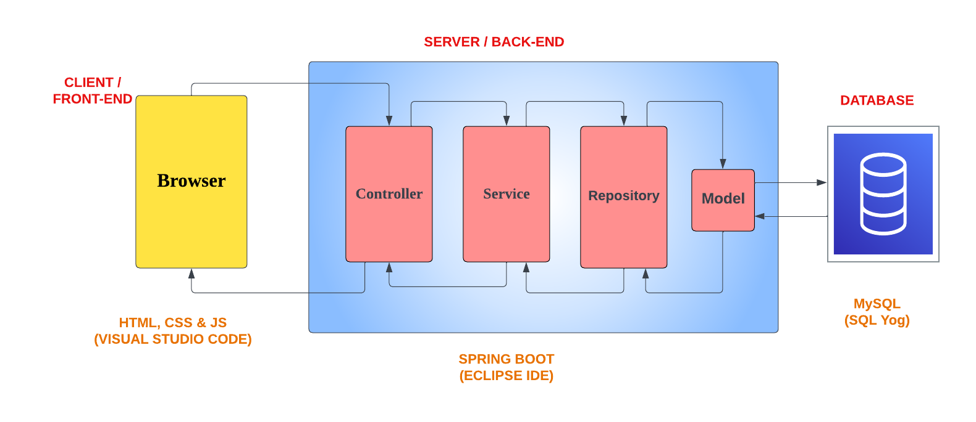
Project Overview
DATA FLOW

Slide 7
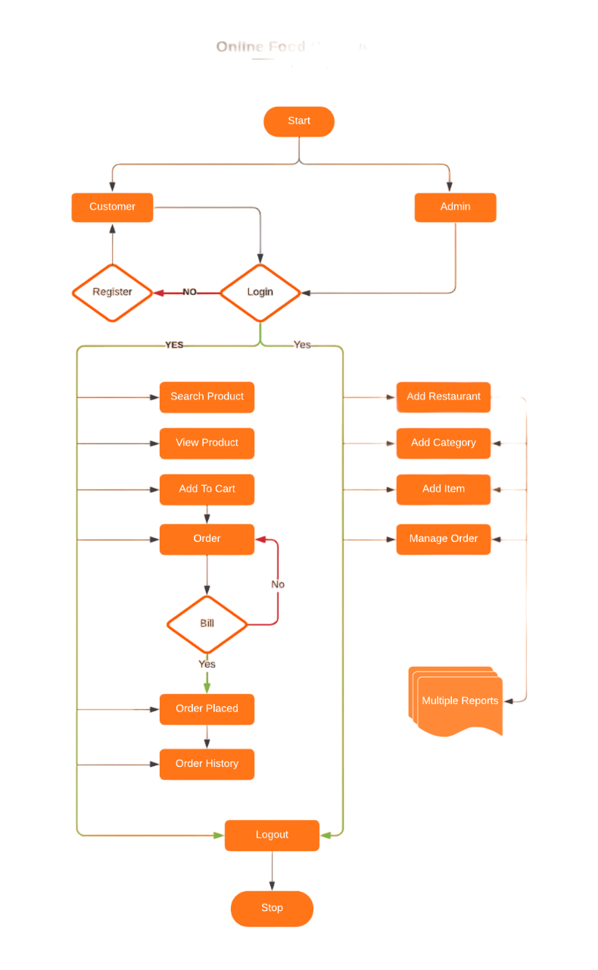
Architecture Design

Slide 8
Architecture Design
DATABASE SCHEMA
Database: hungryhub
Tables:
1)customer(customer_id,age,email,first_name,last_name,mobile_number,password,cart_cart_id)
2)current_user_session(current_session_id,email,login_date_time,private_key,role)
3)address(address_id,area,building_name,city,country,pincode,state,street_no,building_name)
4)admin(admin_id,email,name,password)
5)category(category_id,category_name)
6)food_cart(cartr_id)
7)food_cart_item_list(food_cart_cart_id,item_list_item_id)
8)item(item_id,cost,item_name,quantity,category_category_id)
9)item_restaurants(item_list_item_id,restaurant_restaurant_id)
10)login(user_id,email,password,role)
11)restaurant(restaurant_id,contact_nunber,manager_name,restaurant_name,address_address_id)

Slide 9
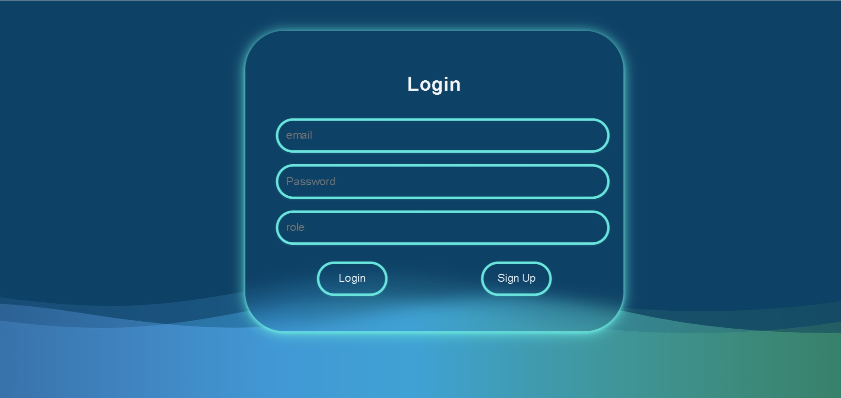
User Interface Design
CUSTOMER LOGIN

Slide 10
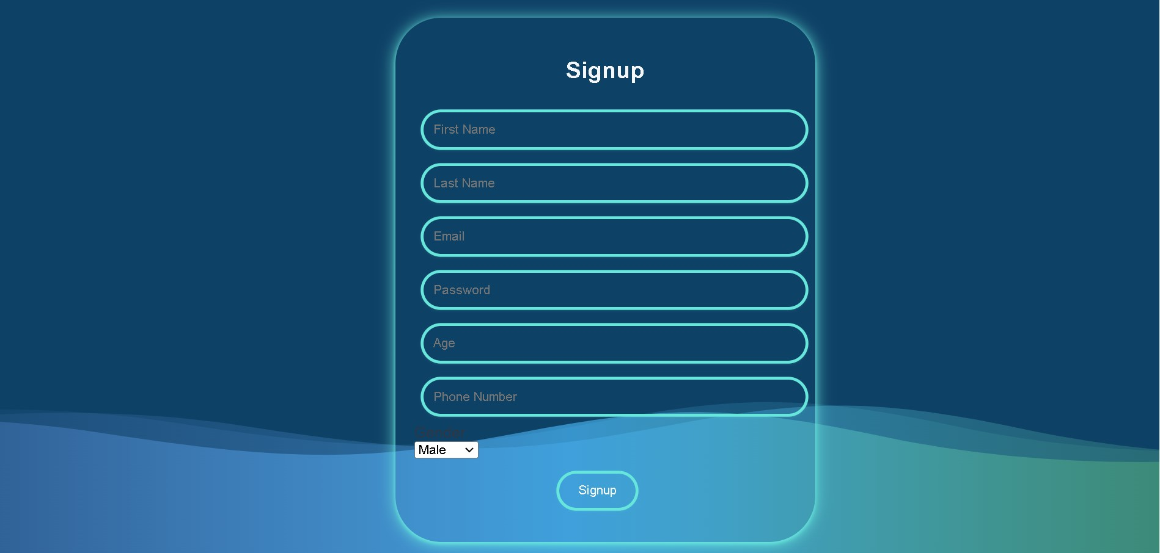
User Interface Design
CUSTOMER SIGN-UP

Slide 11
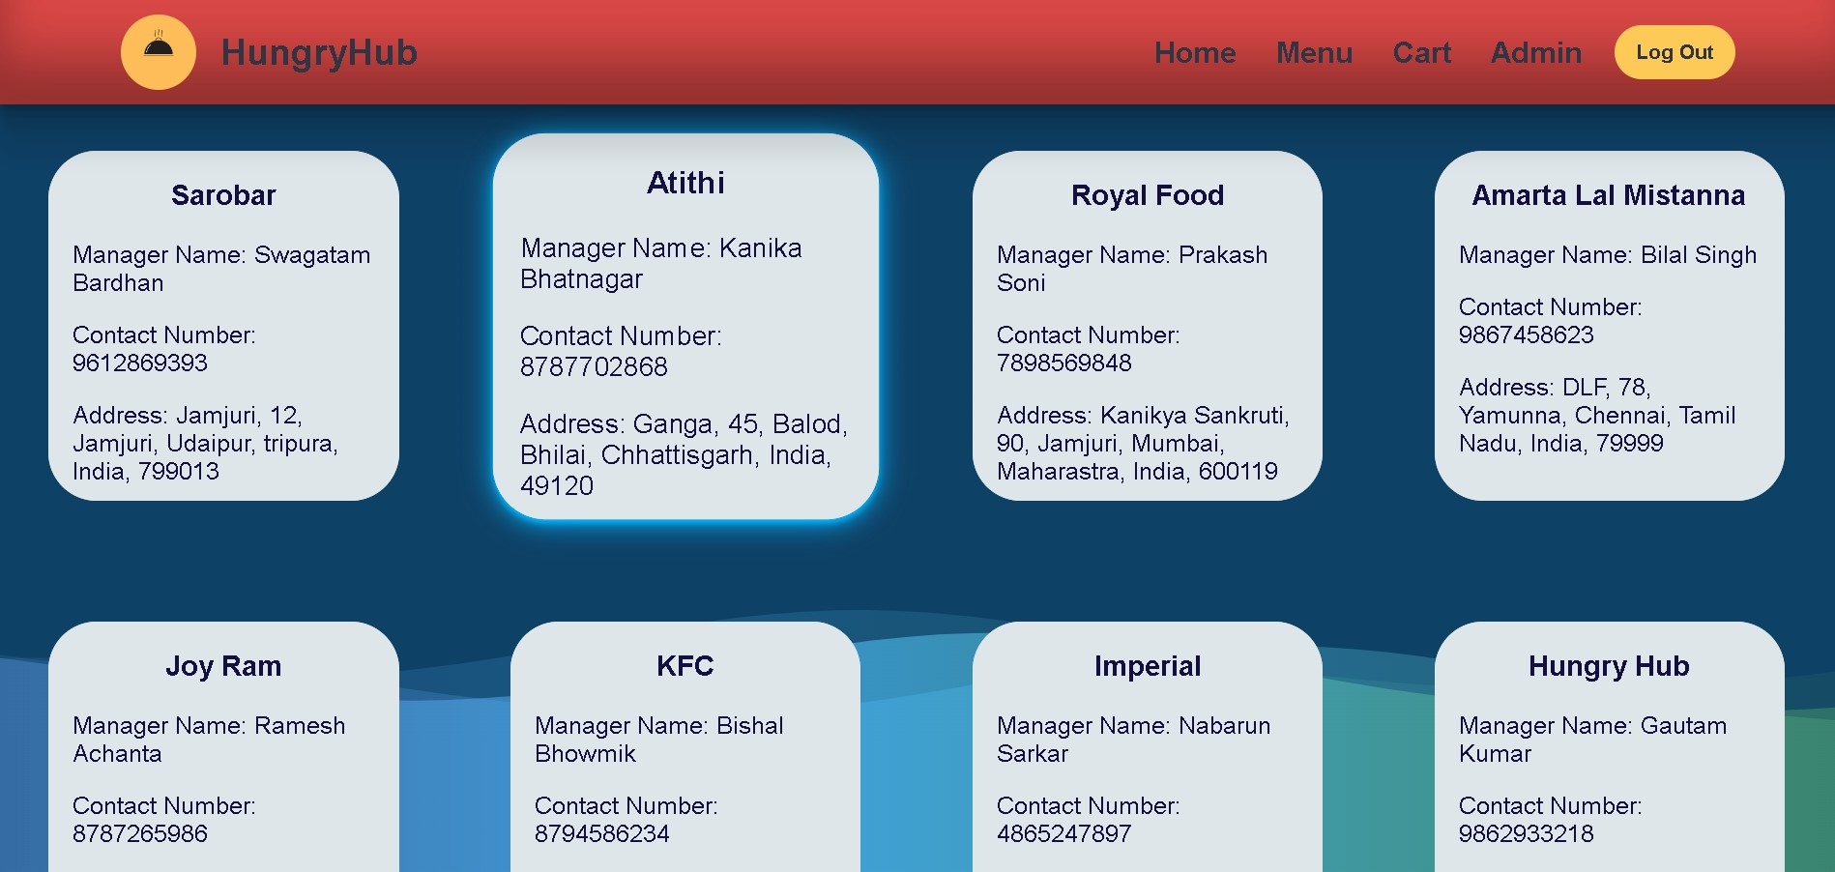
User Interface Design
HOME PAGE

Slide 12
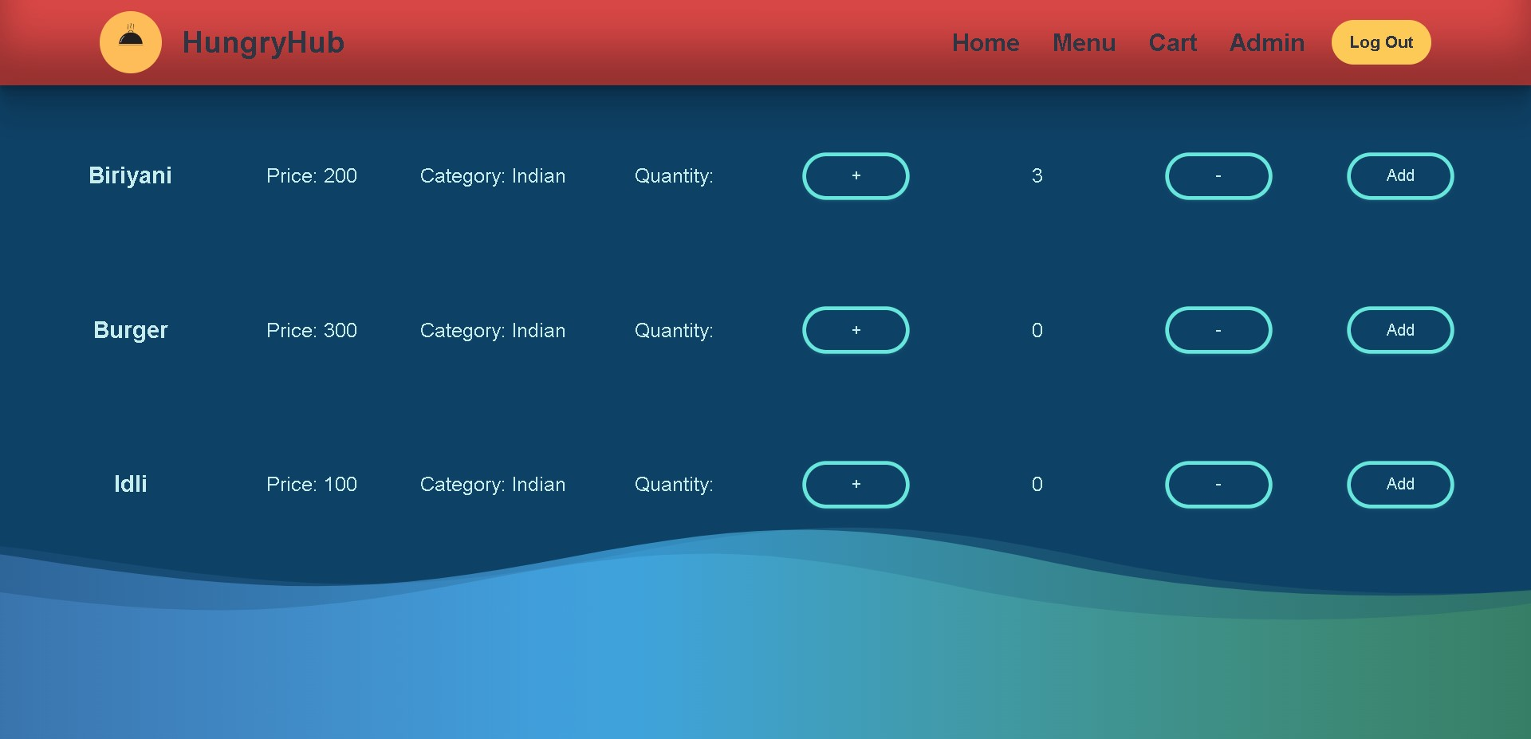
User Interface Design
RESTAURANT MENU

Slide 13
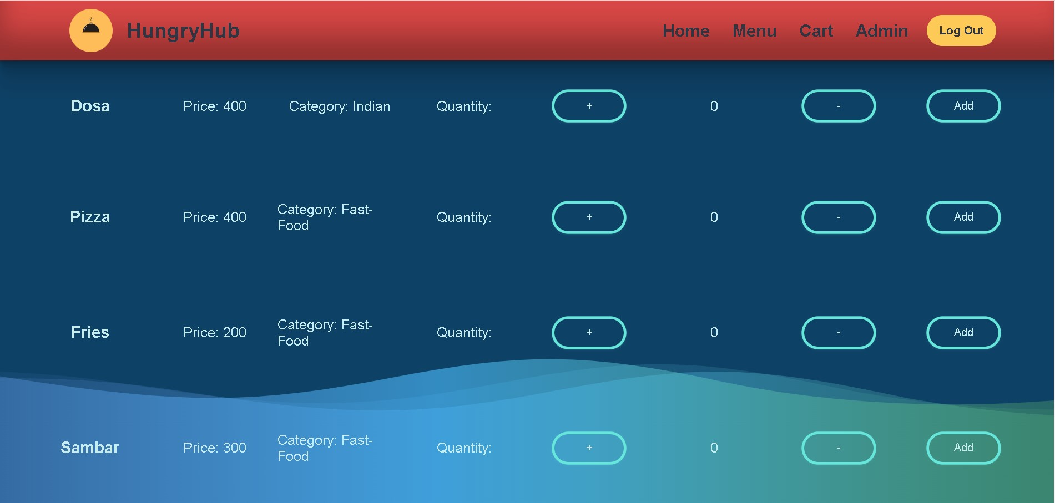
User Interface Design
MENU PAGE

Slide 14
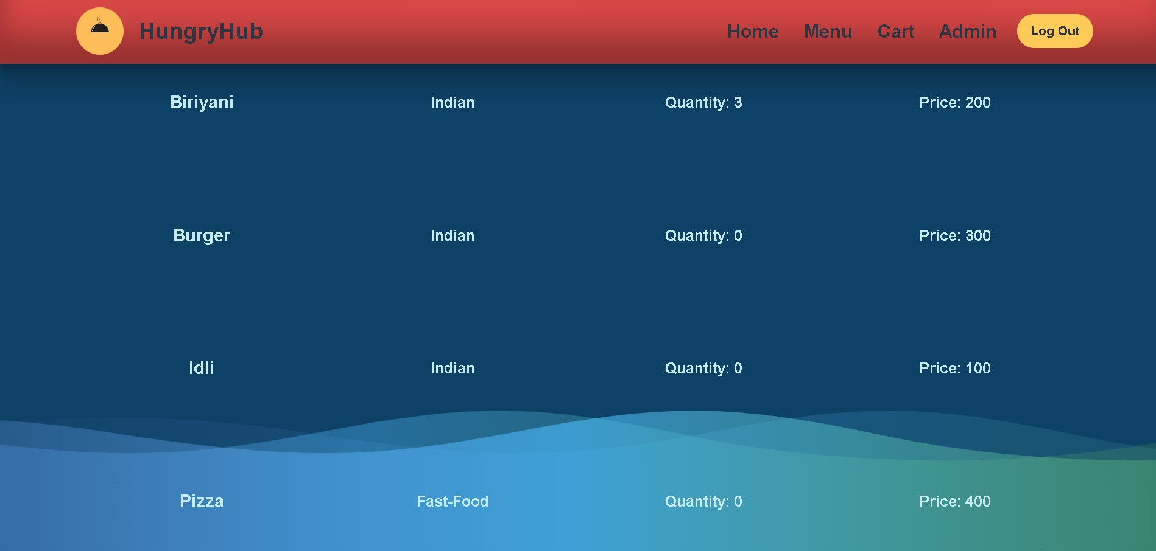
User Interface Design
FOOD CART

Slide 15
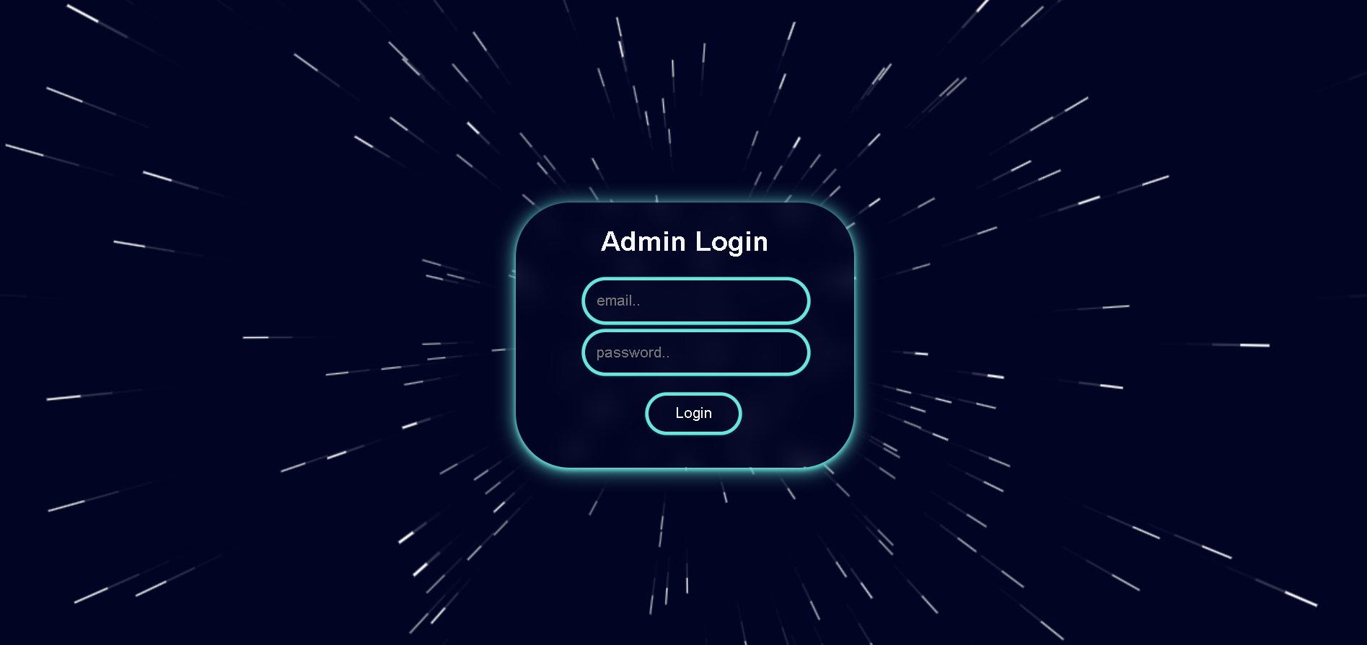
User Interface Design
ADMIN LOGIN

Slide 16
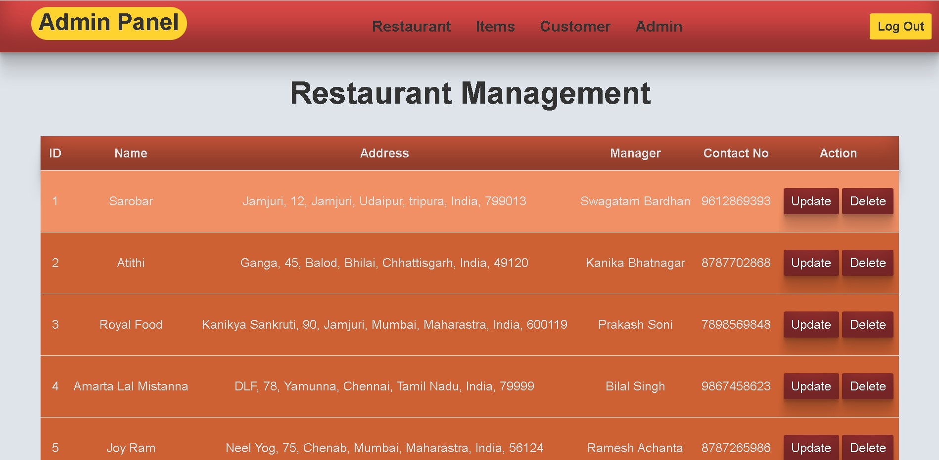
User Interface Design
RESTAURANT MANAGEMENT

Slide 17
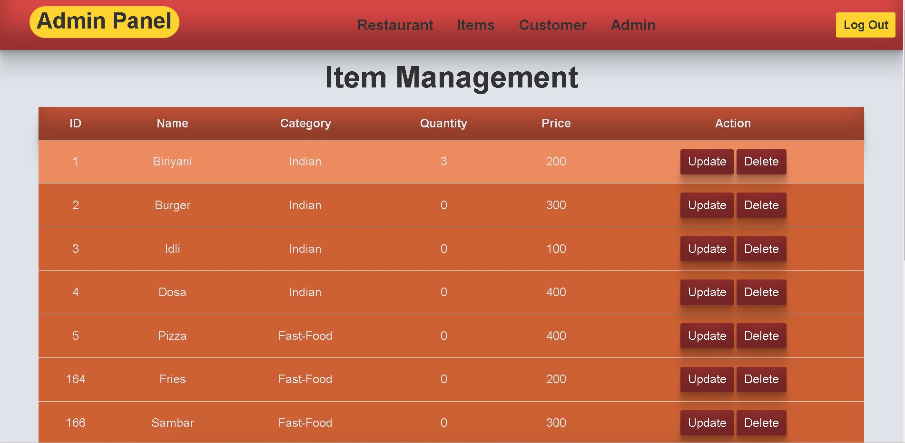
User Interface Design
ITEM MANAGEMENT

Slide 18
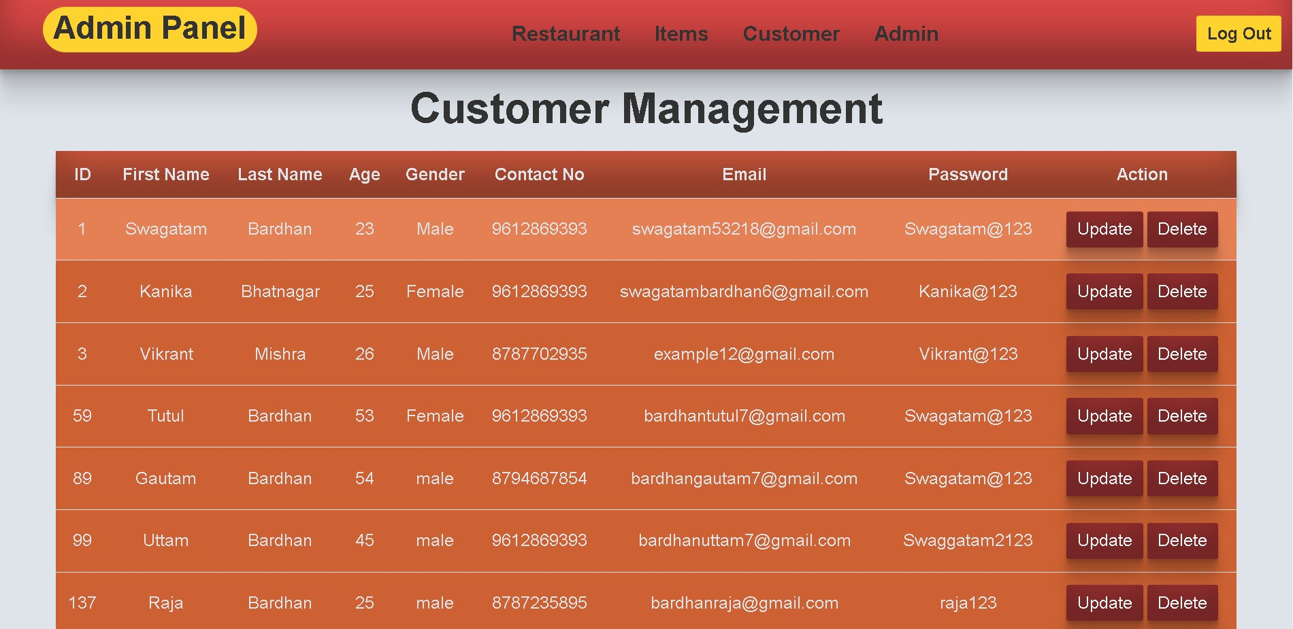
User Interface Design
CUSTOMER MANAGEMENT

Slide 19

Front-End Development
HTML structures the content and layout of a web page
CSS styles the HTML elements
Bootstrap offers pre-designed styles and components for rapid development
JavaScript adds interactivity and dynamic functionality to the website.
Together, these technologies work in harmony to create visually appealing and interactive user interfaces on the web.

Slide 20
Back-End Development
This Implemented the concept of Monolithic Architecture in the back-end architecture:
API: Different APIs have been created in the back-end to meet the application requirements, such as restaurant and menu browsing, user management, and other necessary functionalities.
Utilized Spring MVC for the presentation layer, ensuring seamless interaction with the front-end.
Incorporated Lombok to reduce boilerplate code and enhance code readability.
Leveraged Spring JPA along with Hibernate for efficient database access through the repository layer.
Implemented validation using Spring JPA to ensure data integrity and enforce business rules.
Utilized HttpHeaders to handle HTTP headers, allowing for customization and control over the API responses.
Configured CrossOrigin to enable Cross-Origin Resource Sharing (CORS) and facilitate communication between the front-end and back-end.

Slide 21

Conclusion
HUNGRY HUB represents the future of food delivery, bringing convenience, choice, and efficiency to the fingertips of millions. By leveraging cutting-edge technology and fostering strong partnerships with restaurants, we believe Hungry Hub will transform the way we experience and enjoy food. We are excited to present this innovative solution, and we invite you to explore the possibilities of Hungry Hub.

Slide 22

Future Work
1.Live location & order tracking can be added.
2.Payment gateway can be introduced.
3.User can customize their food order.
4.Show only active order to restaurant vendor.
5.Send an order ready notification to customer.

Slide 23

References
1. Spring Boot Official Documentation:
https://docs.spring.io/spring-boot/docs/current/reference/htmlsingle/
2. Bootstrap Official Documentation:
https://getbootstrap.com/docs/4.0/getting-started/introduction/
3. Oracle Java Tutorails:
https://docs.oracle.com/en/java/

Slide 24
Application Source Code :
https://github.com/Devloperswagatam/Hungry-Hub

Slide 25


